Slide 1
Objectives
In this session, you will learn to:
  Generate payroll statutory reports

Slide 2
Payroll Statutory Reports
Tally.ERP 9 allows you to display and the following statutory forms and reports in the prescribed format as required by the statues:
  Provident Fund (EPF)
  Employee State Insurance (ESI)
  Professional Tax (PT)

Slide 3
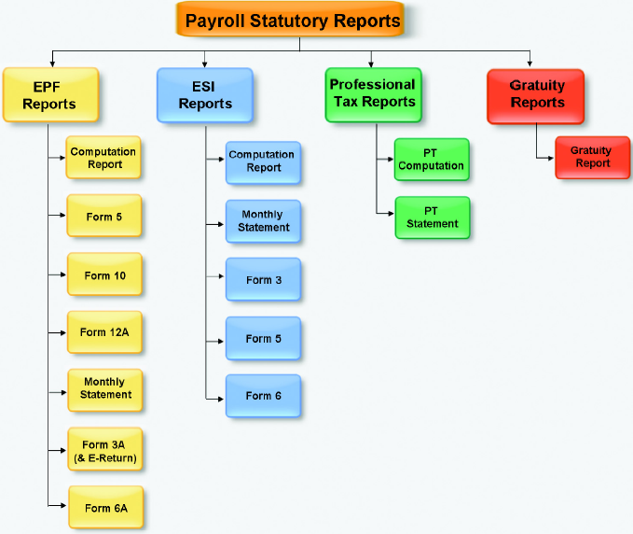
Payroll Statutory Reports (Contd.)
The following figure shows the various statutory reports.

Slide 4
Provident Fund Reports
Provident Fund reports:
  The following Provident Fund reports are available in
  Tally.ERP 9:
    Computation report
    Form 5
    Form 10
    Form 12A
    Monthly Statement
    Form 3A
    Form 6A

Slide 5

Demo: Displaying Provident Fund Reports
Let us see how to display Provident Fund reports in Tally.ERP 9.

Slide 6
Employee’s State Insurance Reports
The following ESI reports are available in Tally.ERP 9:
  Computation Report
  Form 3
  Monthly Statement
  Form 5
  Form 6

Slide 7
Demo: Displaying ESI Reports
Let us see how to display ESI reports in Tally.ERP 9.

Slide 8
Professional Tax Reports
  Tally.ERP 9 provides the following professional tax reports:
  Professional Tax Computation Report
  Professional Tax Statement

Slide 9
Professional Tax Reports (Contd.)
Professional Tax Computation Report:
  Provides the summary of Amount deducted as Professional Tax in accordance with the Slab rates applicable for the particular state, from the Earnings of the Employees exceeding the prescribed threshold limits.

Slide 10
Demo: Displaying Professional Tax Computation Report
Let us see how to display Professional Tax Computation Report in Tally.ERP 9.

Slide 11
Professional Tax Reports (Contd.)
Professional Tax Statement:
  Provides the summary of Employee wise Gross Wages paid, No. of Working Days and the amount of Professional Tax deducted during the selected period.

Slide 12
Demo: Generating Professional Tax Statement
Let us see how to generate Professional Tax Statement in Tally.ERP 9.

Slide 13
Gratuity Report
Gratuity Report:
  Displays the provisional liability of an employer towards his employee in respect of gratuity payable at the time of cessation of employment either by resignation, death, retirement or termination.
  Displays the gratuity amount payable in accordance with the pay components and formulae defined in the ledger master.

Slide 14
Demo: Viewing Gratuity Report
Let us see how to view Gratuity Report in Tally.ERP 9.

Slide 15
Summary
In this session, you learned that:
  Gratuity Summary Report calculates the liability of a company in terms of gratuity.

